Slide 1
Value Set Manager UI Wireframes – Proposed Changes
Authoring & Implementer Workflows

Slide 2
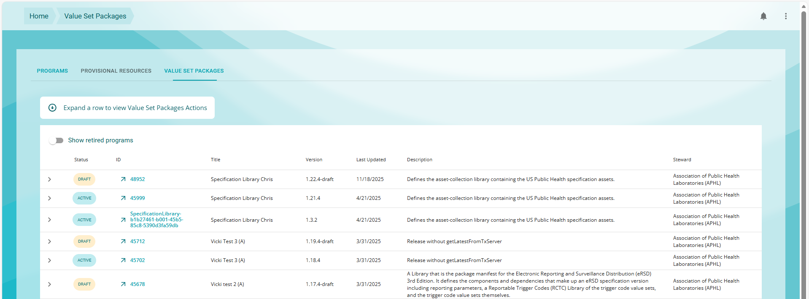
Authoring Workflow (Creators)
Value Set Packages – Same as the Programs page, but it is showing only Value Set Packages for a specific implementation guide
The IG is a URL parameter and otherwise readonly (this page is only ever arrived at from an IG Downloads page)
Display Draft + Active versions of Value Set Package Definitions on this browse
Create a Value Set Package for the selected implementation guide (choose one or disable if none selected), and then takes the user to the Value Set Package Edit
Tab: Value Set Packages
Implementation Guide (IG)
Create new VS Package
Create
uscore 6.1.0

Slide 3

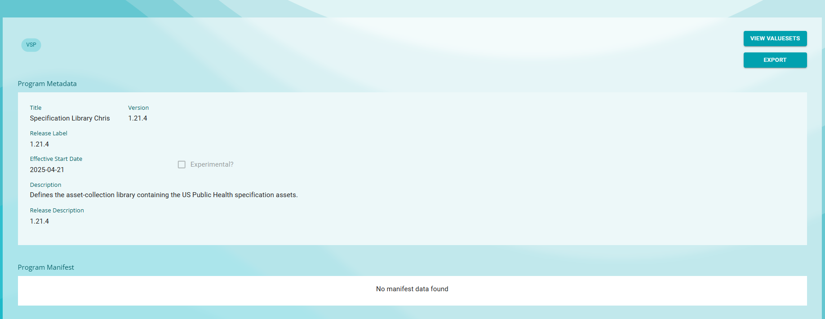
Value Set Package Edit – The IG parameter from the previous tab auto-populates the IG field
Most metadata is defaulted, only “version” can be changed
Version is defaulted to “YYYY-MM” of current date
Manifest will be defaulted based on the published implementation guide
Manifest from the implementation guide expansion parameters

Slide 4
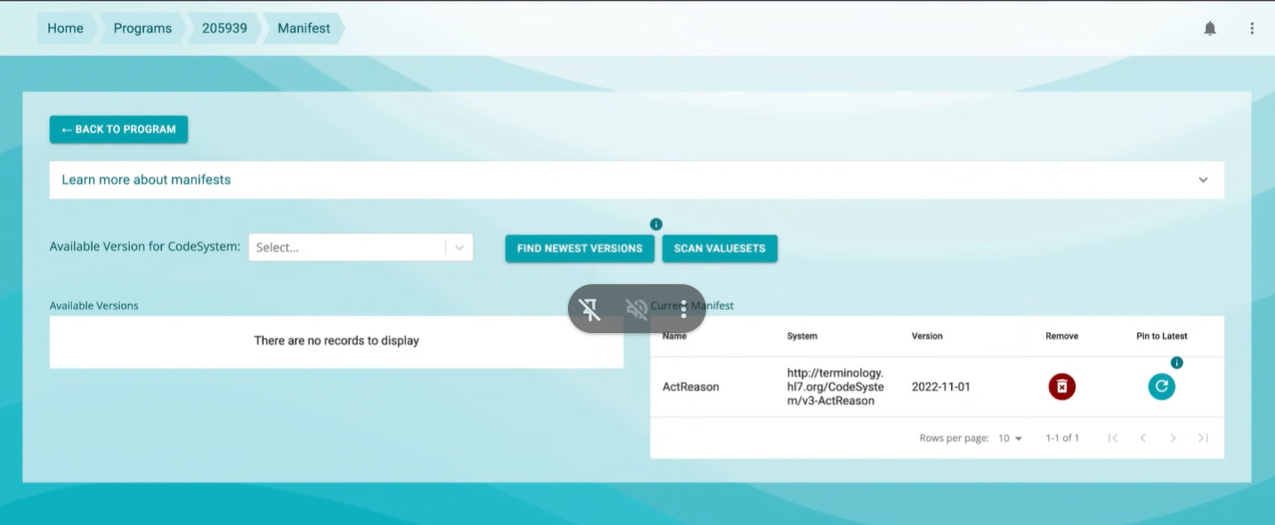
Manifest Edit
On Creation of a new Value Set Package, the manifest will be populated with all CodeSystem and ValueSet dependencies using the package dependency versions
Add the ability to edit value set versions in the manifest by creating a “ValueSet” tab, and putting the current CodeSystem capabilities on a “CodeSystem” tab

Slide 5
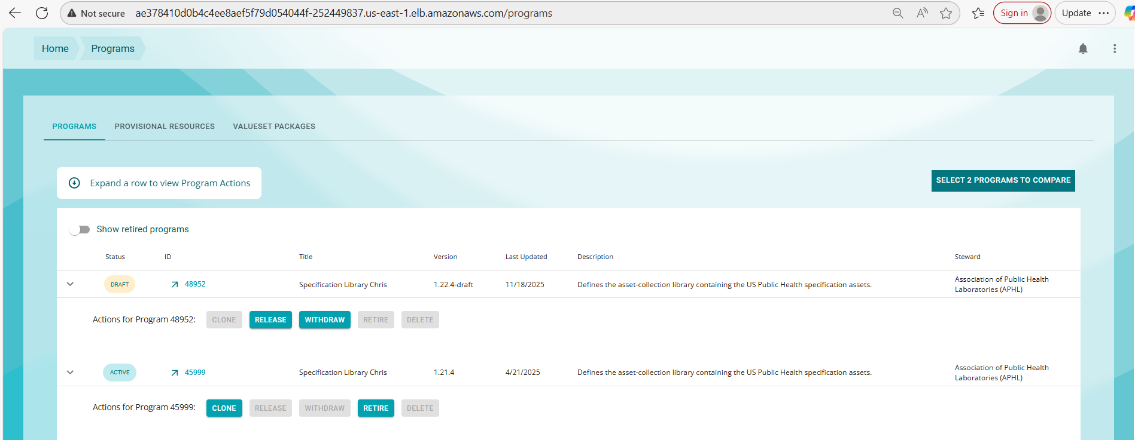
Authors will be able to create, edit, release, withdraw and retire value set packages.

Slide 6
Consumer Workflow
ValueSet Packages
Same as for authors, IG is a parameter to the page, and the page is only ever arrived at from an IG downloads page
Click on Any Value Set Package to review Package Details, ValueSets, Metadata & Manifest.
From inside the Value Set Package, Export – Download the value sets expansions.
Implementers can only view details, compare versions, view value sets and export
Export, View ValueSets
Review Package Details
uscore 6.1.0

